Slide 1

INFO7390 Advanced Data Sciences and Architecture Sentiment Analysis of Amazon Book Reviews and Sentiment classification using deepNet/Darch and MXNet
Presenters
Sushma Suttakote Parameshappa
Final Project

Slide 2
Overview
Web Scrapping
Tokenization and Data Cleaning
Results
Understanding the Problem
Sentimental Analysis
Sentimental Classification

Slide 3
Introduction
Why to perform deep leaning approach on Amazon Books Reviews?
New Product in the market, so we want to understand the problems in it.
We want to know about the sentiments of the product (+ve/-ve) and use it for enhancing the product.
We can fix the shortcoming of the product from the sentiment analysis
Dataset :
Total 5000 reviews and rating of a Book.

Slide 4
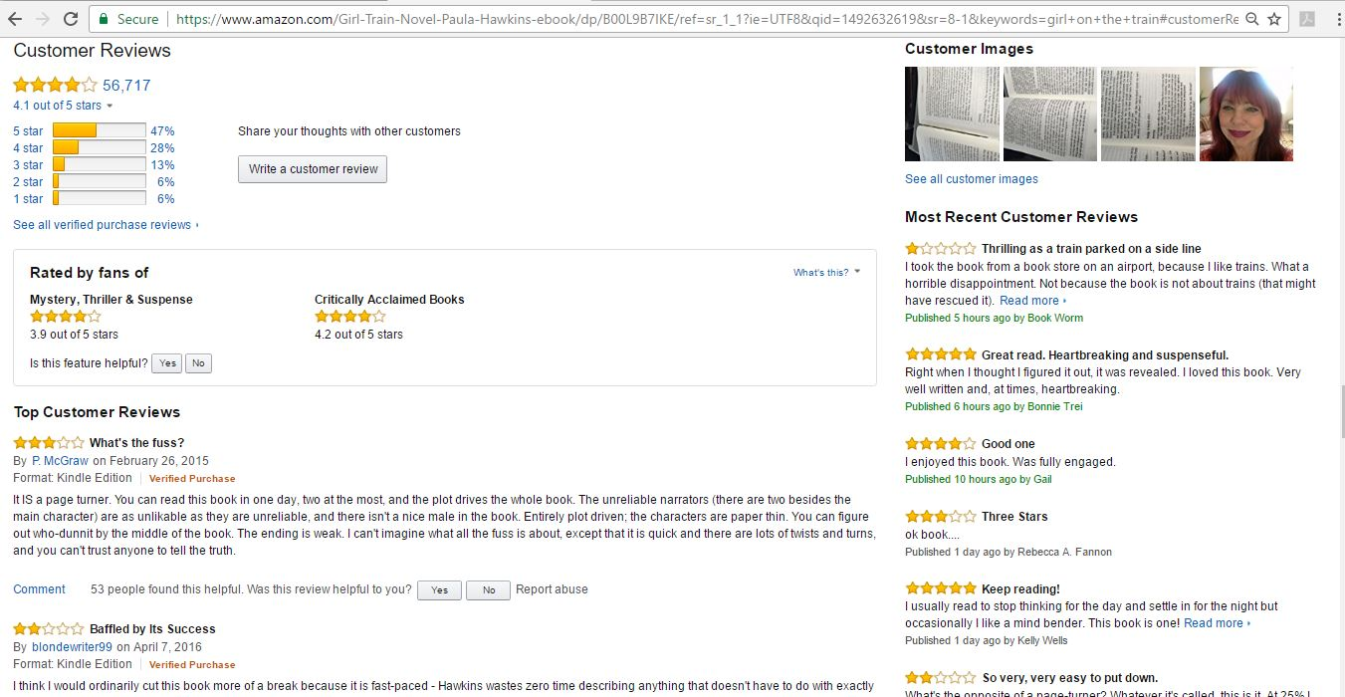
Raw Data : Customer Reviews

Slide 5
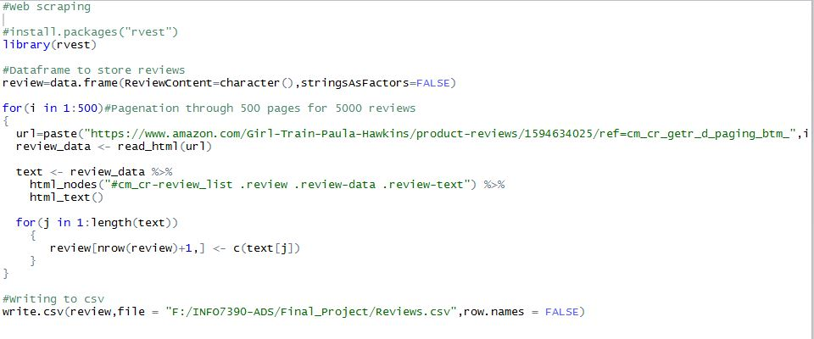
Web Scraping

Slide 6
Sentimental Analysis
Steps:
Lexicon Collection
Pre-processing of the reviews:
Punctuations removal
Numeric data
Stop words
Stemming
For every review, used positive and negative counters
Calculated the positive and negative % to classify the review

Slide 7
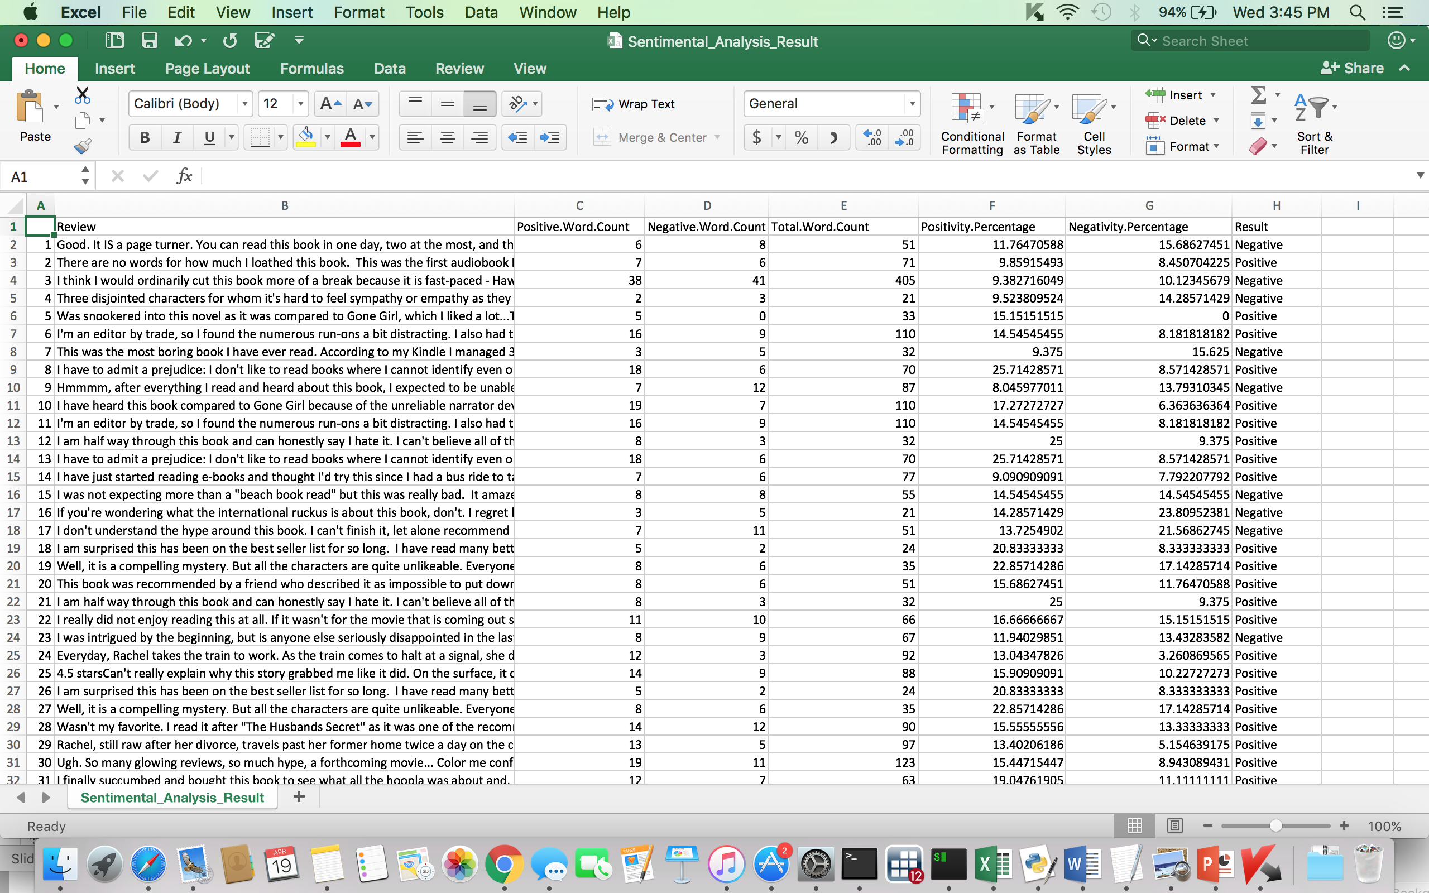
Results: Sentiment Analysis

Slide 8
Data Preparation: Sentimental Classification
Naïve Bayes Classifier : for rating stars
Created a Document Term Matrix

Slide 9
Word Cloud

Slide 10

Support Vector Machines
Supervised learning models with associated learning algorithms that analyze data used for classification and regression analysis

Slide 11
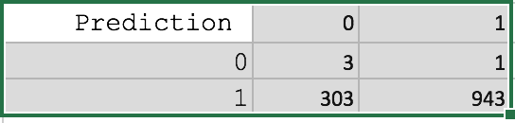

Convolutional Neural Network
CNN is a type of feed-forward artificial neural network in which the connectivity pattern between its neurons

Slide 12
Deep Belief Network
Deep belief network is a generative graphical model, or alternatively a type of deep neural network, composed of multiple layers of latent variables, with connections between the layers but not between units within each layer.

Slide 14
Conclusion
Sentimental Classification Technique | Accuracy(%)
Support Vector Machine | 75.68
Convolutional Neural Network | 75.68
Deep Belief Network | 80.96
From the table above:
Deep Belief Network is the most accurate model for classification of Amazon Book reviews

Slide 15
`

